Slide 1
STRINGS

Slide 2
Introduction
Strings are actually one-dimensional array of characters terminated by a null character '\0'. Thus a null-terminated string contains the characters that comprise the string followed by a null.

Slide 3
Example
To hold the null character at the end of the array, the size of the character array containing the string is one more than the number of characters in the word "Hello."
char greeting[6] = {'H', 'e', 'l', 'l', 'o', '\0'};

Slide 4
Initialization of strings
In C, string can be initialized in a number of different ways.
For convenience and ease, both initialization and declaration are done in the same step.
Using arrays
char c[] = "abcd";
OR,
char c[50] = "abcd";
OR,
char c[] = {'a', 'b', 'c', 'd', '\0'};
OR,
char c[5] = {'a', 'b', 'c', 'd', '\0'};

Slide 5
Input and Display string using printf() and scanf()
void main()
{
char name[20];
printf("Enter name: ");
scanf("%s", &name); // OR scanf(“%s”,name);
printf("Your name is %s.", name);
}
Output:
Enter name: Dennis Ritchie
Your name is Dennis.

Slide 6
Read string with spaces using scanf()
#include <stdio.h>
void main()
{
char name[30];
printf("Enter name: ");
scanf("%[^\n]",name);
printf("Name is: %s\n",name);
}

Slide 7
Read string with spaces using getchar()
#include<stdio.h>
void main()
{
char str[100],ch;
int i=0;
printf("Enter a string:\n");
while(ch!='\n')
{
ch=getchar();
str[i]=ch;
i++;
}
str[i]='\0';
printf("Entered String is:\n");
puts(str);
getch();
}

Slide 8
Input and Display string using gets() and puts()
void main()
{
char name[30];
printf("Enter name: ");
gets(name); //Function to read string from user. printf("Name: ");
puts(name); //Function to display string.
}

Slide 9
Printing a string on the screen
void main( )
{
char name[ ] = " Alen Joe " ;
int i = 0 ;
while ( name[i] != `\0' )
{
printf ( "%c", name[i] ) ;
i++ ;
}
}
Output: Alen Joe

Slide 10
Calculating length of a string
# include <stdio.h>
void main()
{
char str[50];
int i; //counter that will calculate string length
printf("Enter a string: ");
gets(str);
for(i = 0; str[i] != '\0'; i++);
printf("Length of string is: %d", i);
}

Slide 11
Passing Strings to Functions
Strings are just char arrays. So, they can be passed to a function in a similar manner as arrays.

Slide 12
Example
void displayString(char str[]);
void main()
{
char str[50];
printf("Enter string: ");
gets(str);
displayString(str); // Passing string to function.
}
void displayString(char str[])
{
printf("String Output: ");
puts(str);
}

Slide 13
Find out two strings are equal
#include<stdio.h>
void main() {
char str1[30], str2[30];
int i;
printf("\nEnter two strings :");
gets(str1);
gets(str2);
i = 0;
while (str1[i] == str2[i] && str1[i] != '\0')
i++;
if (str1[i] > str2[i])
printf("str1 > str2");
else if (str1[i] < str2[i])
printf("str1 < str2");
else
printf("str1 = str2");
getch();
}

Slide 14
Program to count vowels, consonants
#include <stdio.h>
int main() {
char line[150];
int vowels, consonant, digit, space;
vowels = consonant = digit = space = 0;
printf("Enter a line of string: ");
fgets(line, sizeof(line), stdin);
for (int i = 0; line[i] != '\0'; ++i) {
if (line[i] == 'a' || line[i] == 'e' || line[i] == 'i' || line[i] == 'o' || line[i] == 'u' || line[i] == 'A' || line[i] == 'E' || line[i] == 'I' || line[i] == 'O' || line[i] == 'U')
{
++vowels; }
else if ((line[i] >= 'a' && line[i] <= 'z') || (line[i] >= 'A' && line[i] <= 'Z')) {
++consonant; }
else if (line[i] >= '0' && line[i] <= '9') {
++digit; }
else if (line[i] == ' ') {
++space; } }
printf("Vowels: %d", vowels);
printf("\nConsonants: %d", consonant);
printf("\nDigits: %d", digit);
printf("\nWhite spaces: %d", space); }

Slide 15
Program to check palindrome of a string
#include <stdio.h>
#include <string.h>
void main()
{
char string1[20];
int i, length, flag = 0;
printf("Enter a string:");
scanf("%s", string1);
length = strlen(string1);
for(i=0;i < length ;i++)
{
if(string1[i] != string1[length-i-1])
{ flag = 1;
break;
} }
if (flag) {
printf("%s is not a palindrome", string1);
}
else {
printf("%s is a palindrome", string1);
}
getch();
}

Slide 16
Reverse of a string
#include<stdio.h>
void main()
{
char str[50], i, j, count=0;
printf("Enter any string: ");
gets(str);
for(i=0; str[i]!='\0'; i++)
count++;
for(j=count-1; j>=0; j--)
printf("%c", str[j]);
getch();
}

Slide 17
Pointers and Strings
Suppose we wish to store “Hello”. We may either store it in a string or we may ask the C compiler to store it at some location in memory and assign the address of the string in a char pointer. This is shown below:
char str[ ] = "Hello" ;
char *p = "Hello" ;
There is a subtle difference in usage of these two forms.

Slide 18
Difference 1:
void main( )
{
char str1[ ] = "Hello" ;
char str2[10] ;
char *s = "Good Morning" ;
char *q ;
str2 = str1 ; /* error */
q = s ; /* works */
}

Slide 19
Difference 2:
void main( )
{
char str1[ ] = "Hello" ;
char *p = "Hello" ;
str1 = "Bye" ; /* error */
p = "Bye" ; /* works */
}

Slide 20
Accessing string elements using pointers
void main( )
{
char name[ ] = "Klinsman" ;
char *ptr ;
ptr = name ; /* store base address of string */
while ( *ptr != `\0' )
{
printf ( "%c", *ptr ) ;
ptr++ ;
}
}

Slide 21
Note:
All the following notations refer to the same element:
name[i]
*( name + i )
*( i + name )
i[name]

Slide 22
strcat()
It takes two arguments, i.e, two strings or character arrays, and stores the resultant concatenated string in the first string specified in the argument.
Syntax: strcat(str1,str2);

Slide 23
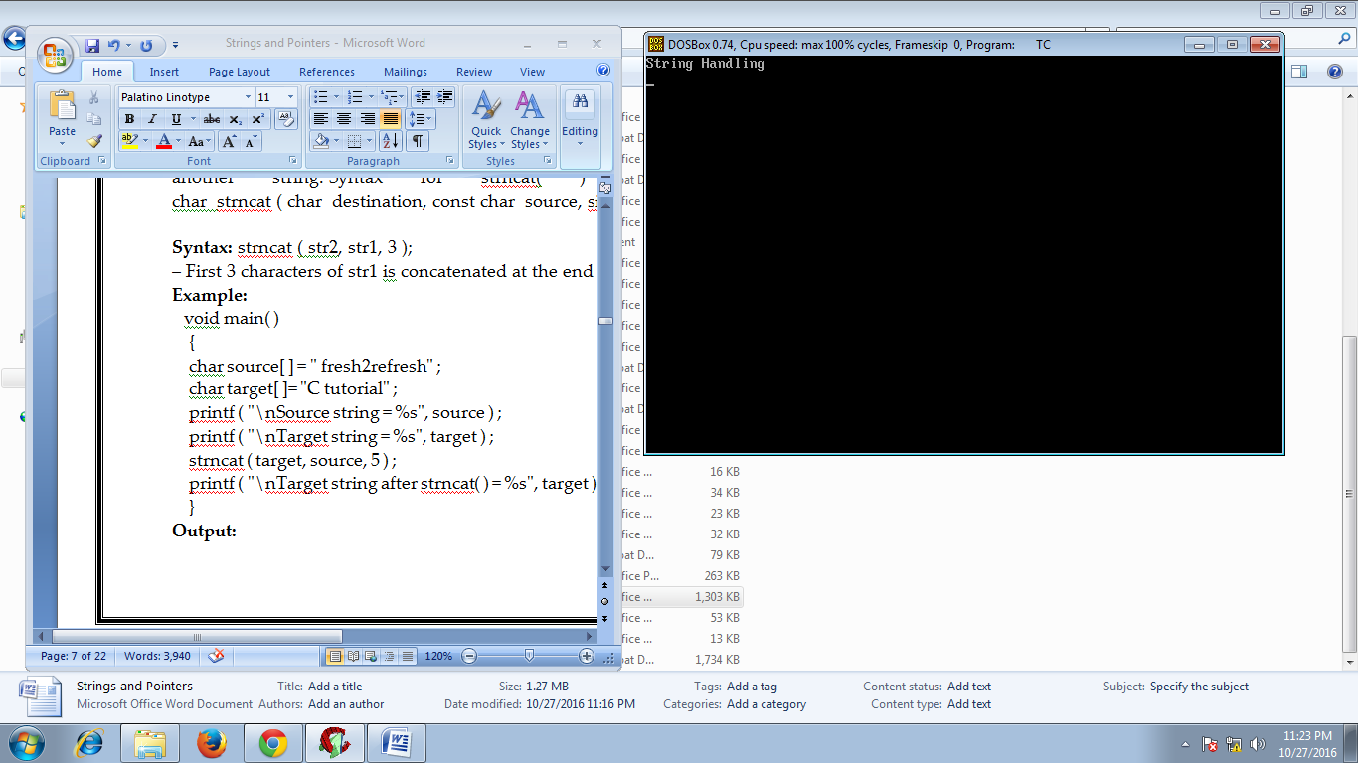
void main()
{
char str1[]="String";
char str2[]=" Handling";
clrscr();
strcat(str1,str2);
puts(str1);
getch();
}

Slide 24
strncat()
strncat( ) function in C language concatenates (appends) portion of one string at the end of another string.
Syntax: strncat ( str2, str1, 3 );

Slide 25
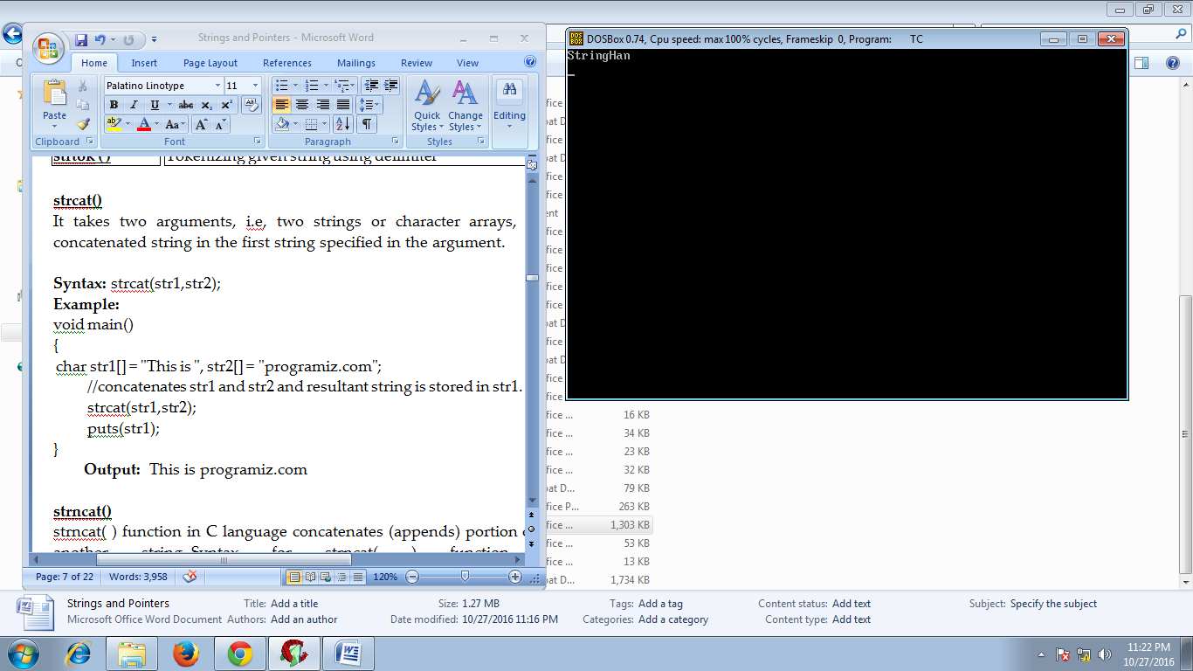
void main()
{
char str1[]="String";
char str2[]="Handling";
clrscr();
strncat(str1,str2,3);
puts(str1);
getch();
}

Slide 26
strcpy()
The strcpy() function copies the string pointed by source (including the null character) to the character array destination.
Syntax: strcpy(target,source);

Slide 27
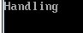
void main()
{
char str1[]="String";
Char str2[]="Handling";
clrscr();
strcpy(str1,str2);
puts(str1);
getch();
}

Slide 28
strncpy()
strncpy( ) function copies portion of contents of one string into another string. Syntax for strncpy( ) function is given below.
Syntax: char strncpy ( char destination, const char source, size_t num );

Slide 29
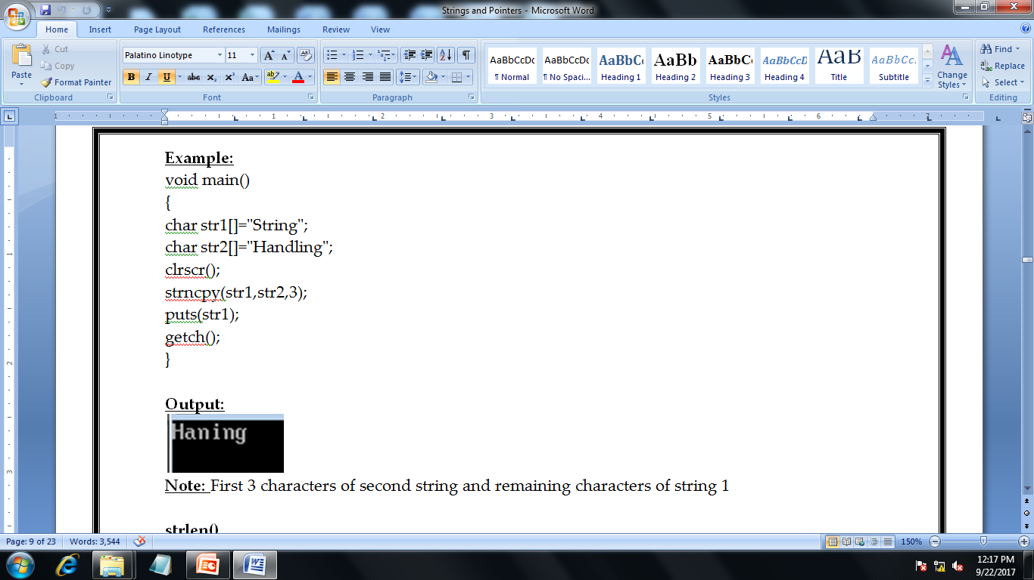

Slide 30
strlen()
The function takes a single argument, i.e, the string variable whose length is to be found, and returns the length of the string passed. The strlen() function is defined in <string.h> header file.
Syntax: strlen(string1)

Slide 31
char a[20]="Program";
printf("Length of string a = %d",strlen(a));
Output: Length of string a =7

Slide 32
strcmp()
The strcmp() compares two strings character by character. If the first character of two strings are equal, next character of two strings are compared. This continues until the corresponding characters of two strings are different or a null character '\0' is reached.
Syntax: strcmp(str1, str2);

Slide 33
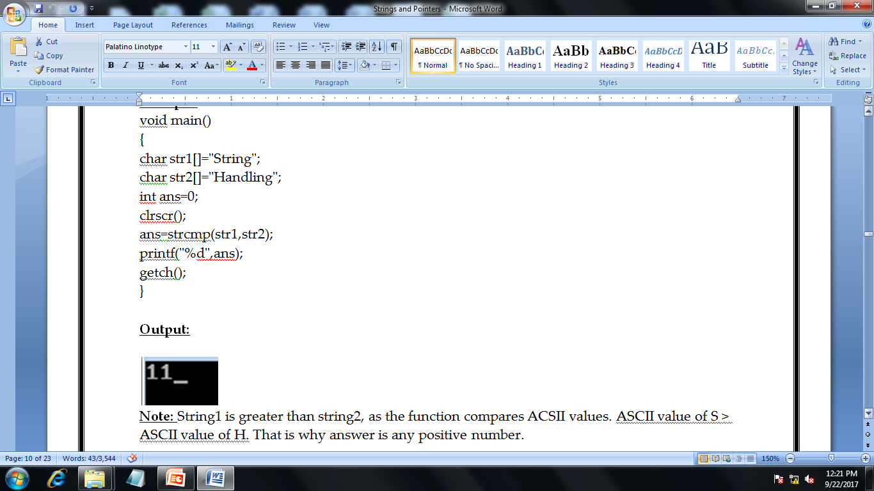

Slide 34
strcmpi()
strcmpi() function is use two compare two strings. strcmp() function does a case insensitive comparison between two strings.
Syntax: strcmpi(string1, string2);

Slide 35
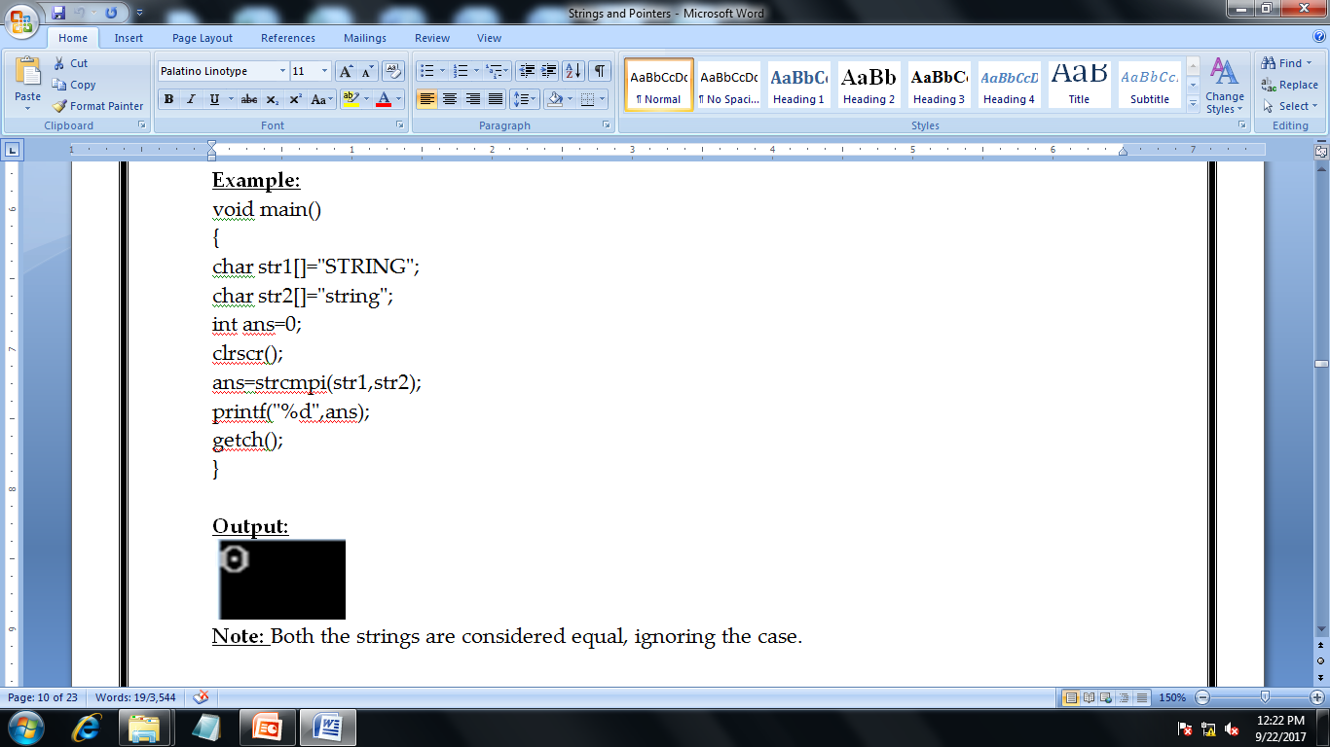

Slide 36
strchr()
strchr( ) function returns pointer to the first occurrence of the character in a given string. Syntax for strchr( ) function is given below.
Syntax: char strchr(const char str, int character);

Slide 37
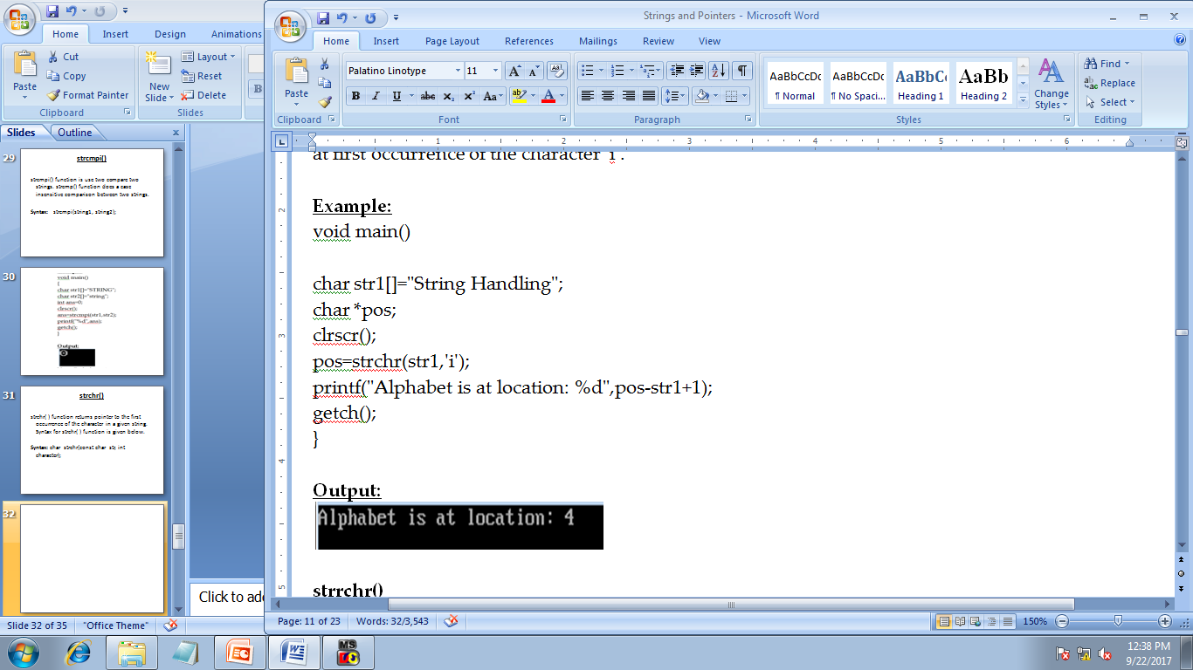

Slide 38
strrchr()
strrchr( ) function in C returns pointer to the last occurrence of the character in a given string. Syntax for strrchr( ) function is given below.
Syntax: char strrchr(const char str, int character);

Slide 39
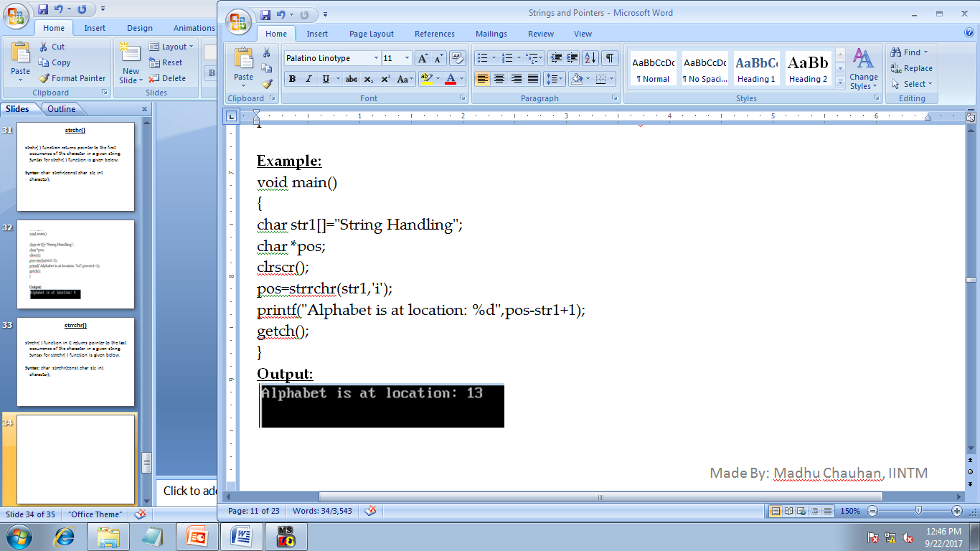

Slide 40
strstr()
strstr( ) function returns pointer to the first occurrence of the string in a given string. Syntax for strstr( ) function is given below.
Syntax:
char strstr(const char str1, const char str2);

Slide 41
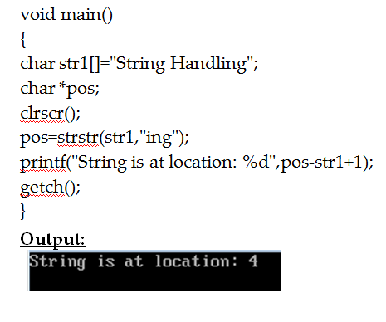

Slide 42
strrstr()
strrstr( ) function returns pointer to the last occurrence of the string in a given string. Syntax for strrstr( ) function is given below.
Syntax: char *strrstr(const char *str1, const char *str2);

Slide 43
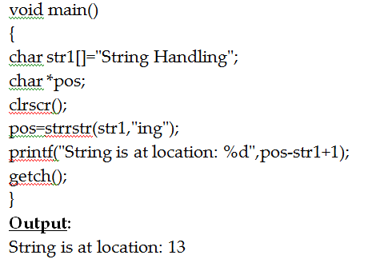

Slide 44
strdup()
strdup( ) function in C duplicates the given string. Syntax for strdup( ) function is given below.
Syntax: char strdup(const char string);

Slide 45
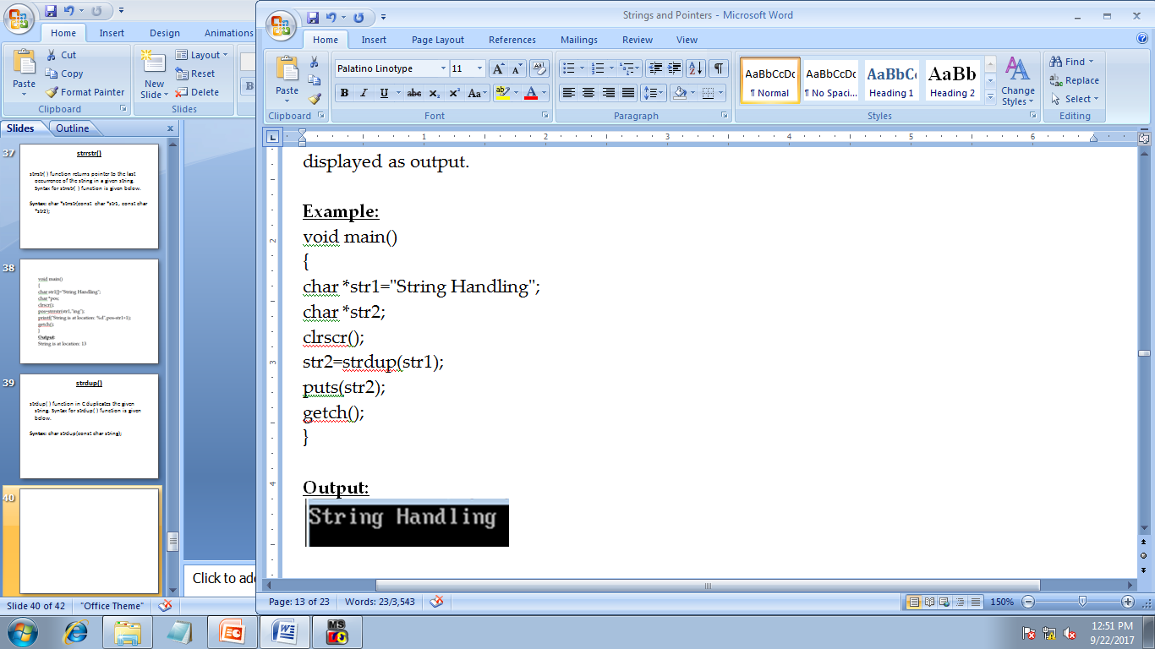

Slide 46
strlwr()
strlwr( ) function converts a given string into lowercase. Syntax for strlwr( ) function is given below.
Syntax: char strlwr(char string);

Slide 47
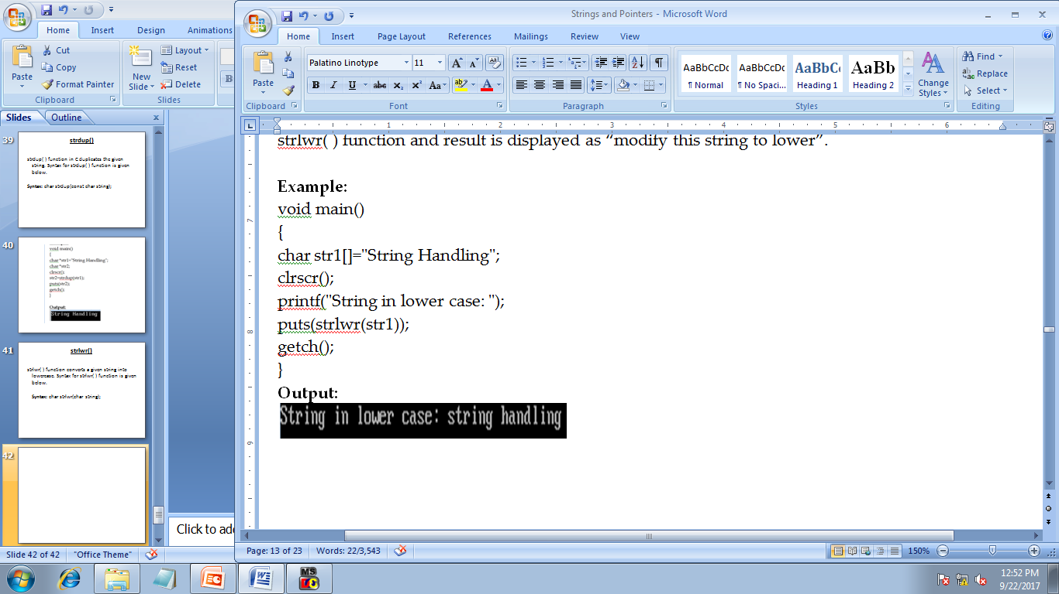

Slide 48
strupr()
strupr( ) function converts a given string into uppercase. Syntax for strupr( ) function is given below.
Syntax: char strupr(char string);

Slide 49
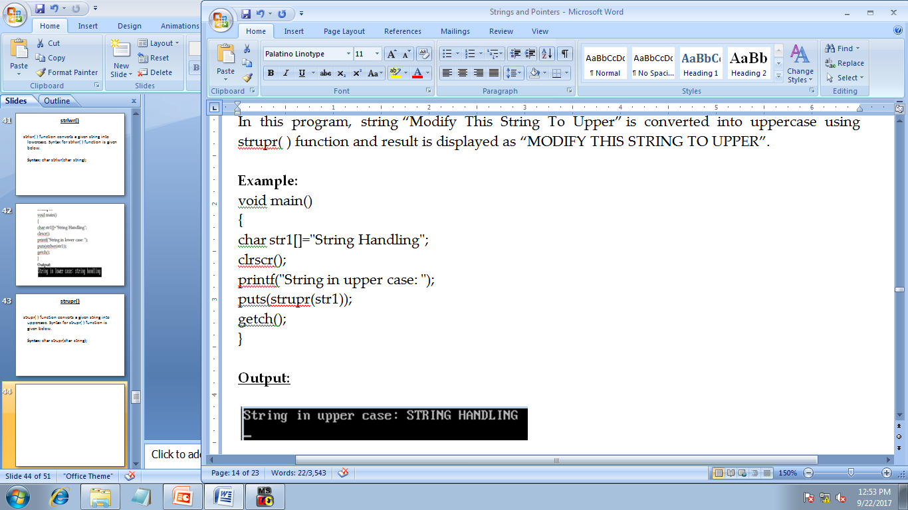

Slide 50
strrev()
strrev( ) function reverses a given string in C language. Syntax for strrev( ) function is given below.
Syntax: char strrev(char string);

Slide 51
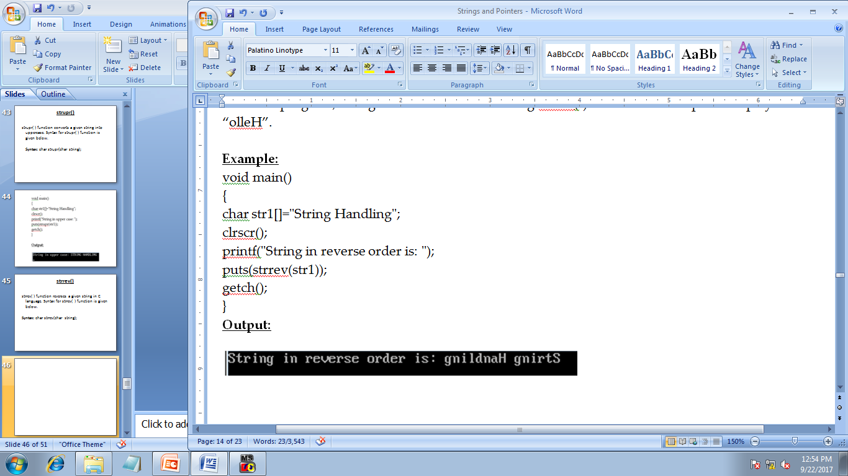

Slide 52
strset()
strset( ) function sets all the characters in a string to given character. Syntax for strset( ) function is given below.
Syntax: char strset(char string, int c);

Slide 53
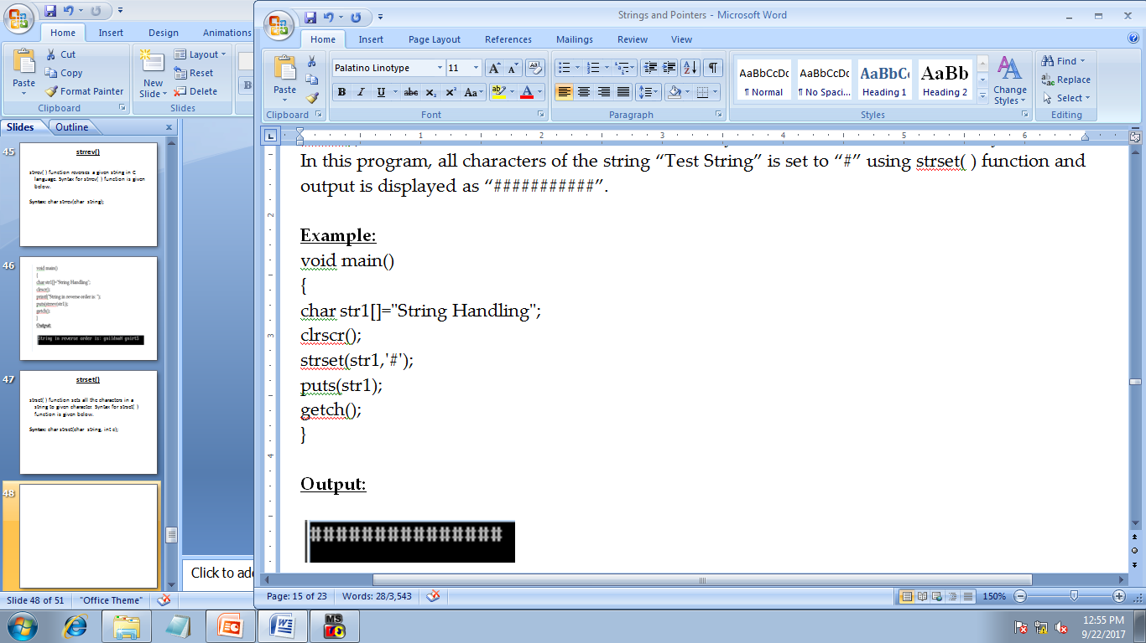

Slide 54
strnset()
strnset( ) function sets portion of characters in a string to given character. Syntax for strnset( ) function is given below.
Syntax: char strnset(char string, int c);

Slide 55
